Slide 1


Prediction of Intrusion Attacks Using Machine Learning Approach
Project Guide: Dr. E. L. N. Kiran Kumar By: Batch – 88 M.SAIGANESH-2003A53011 M.KOUSHIK-2003A53010 P.SHASHI PREETHAM-2003A53001 T.ARAVIND-2003A53014

Slide 2

CONTENTS:
1. Abstract
2. Problem Statement
3. Literature Review
4. Defining Objective of the Project
5. Proposed Plan
6. Input Data &Tech Stack
7. Implementation
8. Results
9. References
10.Conclusion and Future Scope

Slide 3

1.Abstract
Cyber-attacks are an important issue faced by all organizations. Securing information systems iscritical. Organizations should be able to understand the ecosystem and predict attacks. The cyber-physical attacks worldwide have necessitated intense research efforts towards the design of attack detection and prediction mechanisms. Such attacks has been proposed using Deep learning techniques which have shown promising results for predicting intrusions in computer networks. Our approach is to address prediction of attack, severity of attack would help systems to take preventive measures on time.Our results would help determine the attack analysis and provide the necessaryrecommendations to identify the causality and provide the inputs for predictive analytics.
Keywords: Intrusion detection, DDOS Attack , KDD 1999 Data set,Logistic Regression.

Slide 4

2.Problem Statement
Prediction of cyber-physical attacks, threat detection and minimizing the risk of unauthorized access and data compromise.
CLASSIFICATION – PHASE-1: Decision Tree , Random Forest , Gradient Boost, Support Vector Machine.
PREDICTION – PHASE-2: Logistic Regression and State of the Art.
Development– PHASE-3:Implementation of Django Frame work for integration of Pickle Files and User Interface.

Slide 5

3.Literature Review
An Artificial Neural Network Technique for Prediction of Cyber Attack using Intrusion Detection System
Authors: Jay Kumar Jain, Akhilesh A Waoo.
1. A neural network approach to Intrusion Detection System threat prediction.
2. Data set:- NSL-KDD Dataset.
3. Algorithm:- ANN(artificial neural network classifier).
4. Overall accuracy is 99.9% by proposed ANN algorithm with 0.01% of classification error .

Slide 6
Literature Review(Cont.)
Prediction Intrusion in a Network Traffic using Variance of Neighboring Object’s Distance.
Authors: Krishna Gopal Sharma, Yashpal Singh.
1. Prediction Intrusion in a Network Traffic using Variance of Neighboring Object’s Distance uses these Algorithms used are:- KNN,NNDV Binary Class Predictor.
2. Accuracy are:-KNNcup-99 – 0.96%NNDV – 0.99%

Slide 7

Literature Review(Cont.)
Deep Learning Approach for SDN—Enabled Intrusion Detection System in IoT Networks. Authors: Rajasekhar Chaganti, Wael Suliman, Vinaya Kumar Ravi, Amit Dua.
1. Deep learning owing to prevalence of IoT, LSTM, SVM, DOS & DDoS attack, Network attack on ML/DL algorithm techniques uses RNN(Recursive Neural Network).
2. Data set – NSL-KDD data set , KDDCup’99, non-IoT & UNSW-NB15 to train the dataset. 3. Accuracy –NSL-KDD : 81.9%, KDDCup’99 : 96.03%, NSL-KDD : 95.98%, SDN-IoT : 97.1%.4. Overall Accuracy is : 97.1%.

Slide 8

Literature Review(Cont.)
Cyber Security Event Detection using Machine Learning Techniques.
Authors: Salman Muneer, Muhammad Bux Alvi, Amina Farrakh.
1. Classifiers used are naïve Bayes, Bayesian, SVM,KNN based on brain networks & self –association guidelines and references inside .
2. AI strategies : SVM, DT, RF, LR,ANN, KNN
3. Intrusion attacks: AIDS(Anomaly-based IDS) & SIDS(Signature-based IDS) & uses supervised , unsupervised techniques.
4. Overall Accuracy based on the supervised machine learning outcomes.

Slide 9

Literature Review(Cont.)
Hierarchical Intrusion Detection using Machine Learning and Knowledge Model.
Authors: Martin Sarnovsky, Jan Paralic.
1. Goal – symmetrical combination of the knowledge-based approach ML –techniques to build a Hierarchical IDS able to support detection of existing types and severity of network attacks.
2. Algorithms used – Random Forest and PA Forest.
3. Datasets with accuracy – The model was tested on KDD 99, CICIDS 2017 & NSL-KDD datasets of 99.9% on KDD, 96.8% on CICIDS 2017 and 99.1% on NSL-KDD.

Slide 10
4.Defining Objective of the Project
Develop a robust machine learning model capable of accurately identifying intrusion attacks within a computer network.
Give Proper Recommendations to the end-users who will be using the application.
Define evaluation metrics such as accuracy, precision, recall, F1 score, and loss.
Predict the Intrusion attack and the class of attack.

Slide 11

5.Proposed Plan
After the detail Investigation on CICIDS 2017 Dataset, we have came to conclusion that we need to predict the Intrusion attacks in Network ratherthan web security attacks, so we have selected the KDD CUP data set is the best dataset for Prediction of Intrusion Attacks.
The Dataset was so huge ,so we have thought to select the a sample of Dataset for developing the Machine Learning Model.
In the Dataset there were no Recommendations for the attack and Class of Attack Type in the dataset.
This Photo by Unknown Author is licensed under CC BY

Slide 12
Proposed Plan (cont.)
After detail research we have Modified the dataset By Adding 2 extra Columns in the Dataset.
PHASE -1:Collecting sample of KDDCUP 99 Dataset, Pre-processing the data.
PHASE -2:Including the 2 columns in the KDDCUP Dataset, Splitting the Dataset for training and testing.
PHASE -3:Implementing the intrusion attack prediction model, Displaying the Appropriate results and recommendations based on corresponding Inputs. SOTA,Django.

Slide 13

6.Input Data &Tech Stack
Data Set:
we have taken the dataset from KDD’1999 year and Made few changes added few columns in the dataset.
Used Modified Dataset for Developing Machine Learning Model.Tech-Stack:
HTML , CSS ,JS ,Python(3.7) and Framework(Django).

Slide 14

7.Implementation
We should enter the login details.
We should enter input details.
If we submit we can see Details of Attack like attack and class of attack ,recommendations and precautions.
If we click on Graphical Analysis we can see the confusion Matrix and Model test Metrics.
If we click on Logout,we get back to index screen(login page).

Slide 15

8.Results

Slide 16
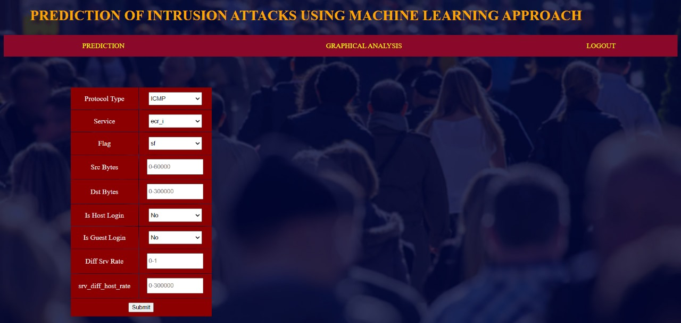
Results

Slide 17

Results

Slide 18

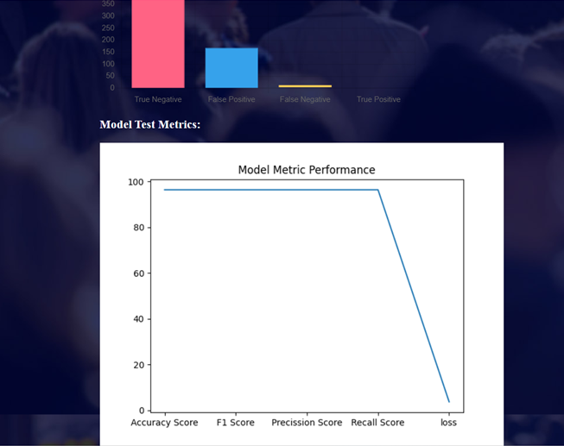
Results

Slide 19
9.References
[1]Jain, J. K., & Waoo, A. A. (2023). An Artificial Neural Network Technique for Prediction of Cyber-Attack using Intrusion Detection System. Journal of Artificial Intelligence, Machine Learning and Neural Network (JAIMLNN) ISSN: 2799-1172, 3(02), 33-42.
[3]Chaganti, R., Suliman, W., Ravi, V., & Dua, A. (2023). Deep learning approach for SDN-enabled intrusion detection system in IoT networks. Information, 14(1), 41.
[4]Muneer, S. M., Alvi, M. B., & Farrakh, A. (2023). Cyber Security Event Detection Using Machine Learning Technique. International Journal of Computational and Innovative Sciences, 2(2), 42-46.
[5]Sarnovsky, M., & Paralic, J. (2020). Hierarchical intrusion detection using machine learning and knowledge model. Symmetry, 12(2), 203.
[2]Sharma, K. G., & Singh, Y. (2023). Predicting Intrusion in a Network Traffic Using Variance of Neighbouring Object’s Distance. International Journal of Computer Network and Information Security, 13(2), 73.

Slide 20
10.Conclusion and Future Scope
We have also identified attacks which are highly occurred in the cyber physical systems and there damaged to the systems. We have applied the state of art model(SOTA/Hybrid Model) using KDD dataset to validate our research questions. From our analysis we found that Gradient Boost and SVM model perform better with 90% accuracy predicting attacks. In addition to this, explanation with possible recommendations to address these attacks, our results are in line with existing state of cyber physical models. In Future we expect researchers to predict the attacks possible with respective to time based and content based attacks.

Slide 21

Thank you

